Slide 1




data_wrangling() &&
("manipulation" %in% R)
🐨🐟🌿 %>% %>% %>% 🤓📊🥰
postgraduate_workshop(
dept = "Biological Sciences",
presenter = c(
"Ruan van Mazijk",
"MSc candidate"
)
)
> face()
> logos()

Slide 2
A motivating example…

Slide 3
An example data-collection scenario in biology

Slide 4
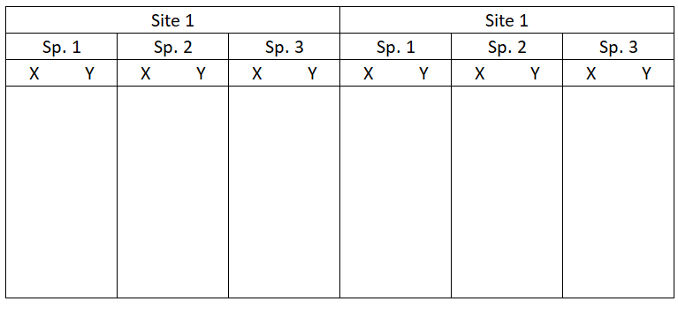
One way to lay out your collected data… 🤢

Slide 5
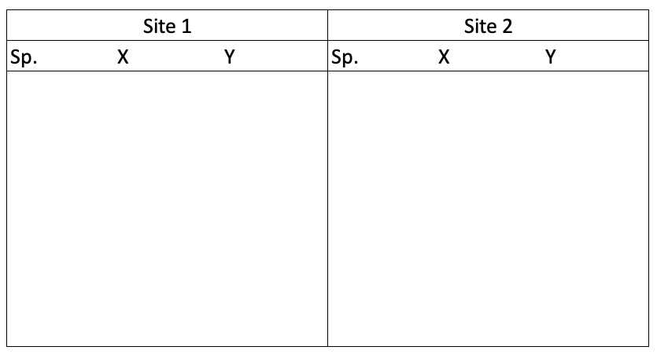
Another way… 😬

Slide 6
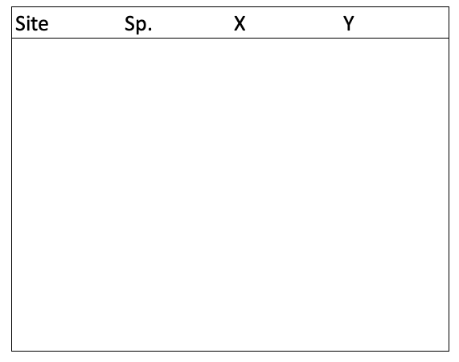
😍😘
👄😳
The “best” way.
(Will make your life easiest in the long-term.)

Slide 7
> outline()
Embracing the rectangle
Making your data rectangular
Things to see & do in rectangle land
mutate() & friends
(How to extend your raw dataset)
Complicated Exotic problems

